Slide 1
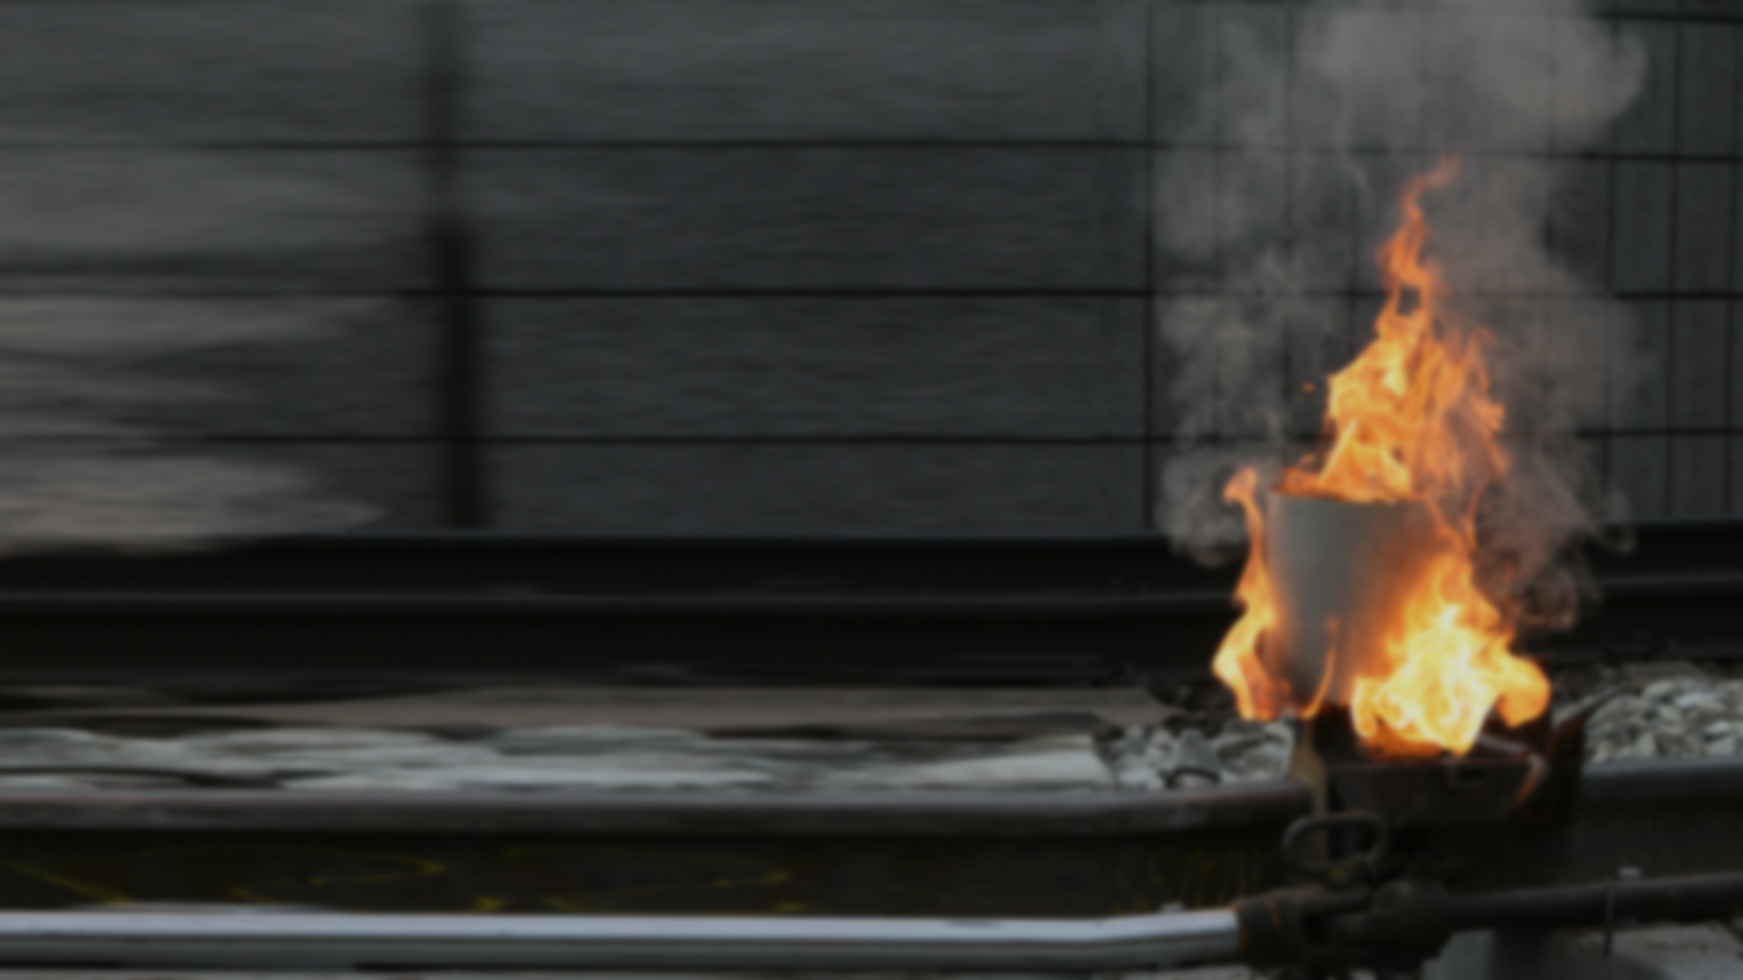

^{Graz University of Technology}
Institute of Railway Engineering and Transport Economics
Header – Verdana – 32pt
City, xx.xx.xxxx
Title Surname Name
mob: +43xxxx
mail: email@tugraz.at
web: www.ebw.tugraz.at
 www.ebw.tugraz.at

Slide 2
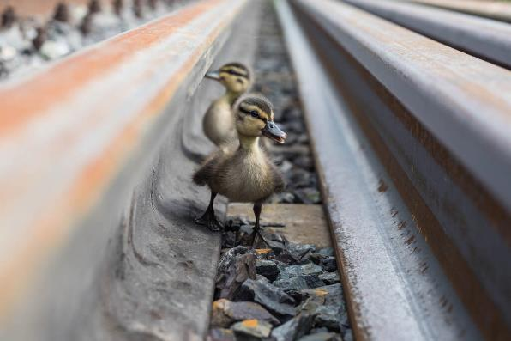
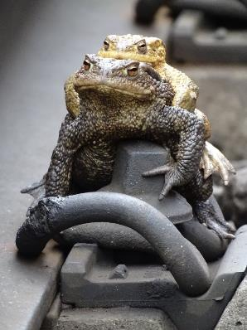
Let’s get our Ducks in a Row! Join Forces!
https://create.vista.com/de/unlimited/stock-photos/420313874/stock-photo-two-cute-little-ducklings-one/ from reginaerofeeva93@yandex.ru
TU Graz (Landgraf)

Slide 3
Agenda
09.00 – 10.30 Chapter 1
10.30 – 10.45 Break
10.45 – 12.45 Chapter 2
12.45 – 14.00 Lunch Break
14.00 – 15.00 Chapter 3
15.00 – 15.15 Break
15.15 – 16.45 Chapter 4

Slide 4
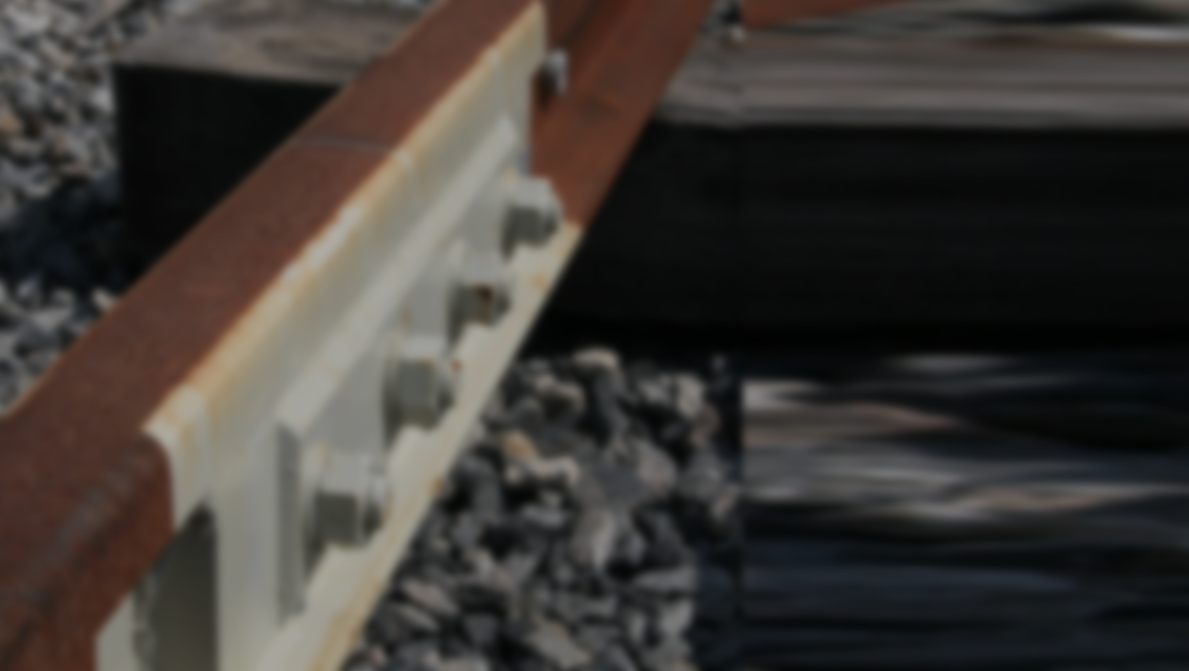
^{Graz University of Technology}
Institute of Railway Engineering and Transport Economics
Header – Verdana – 32pt
Sub-Header – Verdana – 24pt
 www.ebw.tugraz.at

Slide 5

Header – Verdana – 24pt
Text – Verdana – 16pt
Text – Verdana – 16pt
Text – Verdana – 16pt
Text – Verdana – 16pt
Text – Verdana – 16pt
Text – Verdana – 16pt
Text – Verdana – 16pt

Slide 6
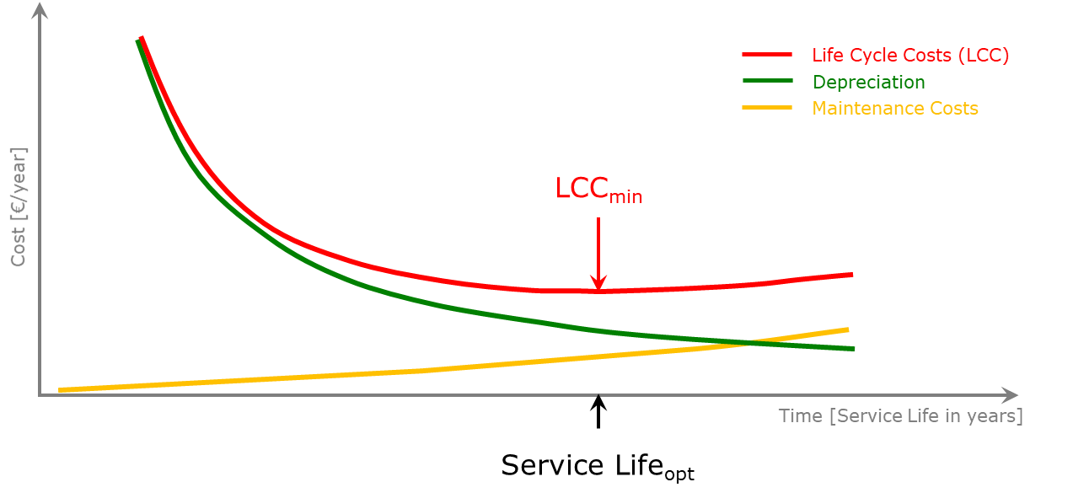
Header – Verdana – 24pt | Sub-Header – Verdana – 18pt
  Text – Verdana – 16pt
Depreciation: Text – Verdana – 16pt
Maintenance: Text – Verdana – 16pt
Total LCC: Text – Verdana – 16pt
Cost of Operational Hindrances: Text – Verdana – 16pt

Slide 7
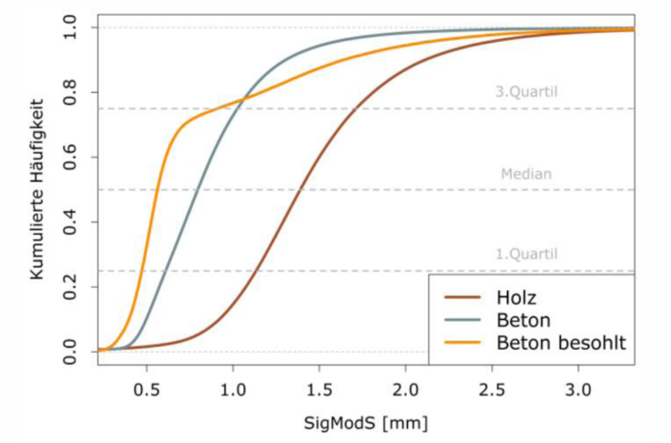



Component Condition | Standard Deviation of modified Gauge (SigModS)
  Have a look!
  Also the figure is labelled in Verdana ;-) (although in German…)

Slide 8
Colour Code
Sleeper
Wooden
Rails
60E1
Concrete
54E2
Concrete USP
49E1
other
other
Radii Classes
R>3,000m
Rail Steel Grade
R260
1,000m<R<3,000m
R350HT
600m<R<1,000m
R400HT
400m<R<600m
other
250m<R<400m
Loading
>25mio.
R<250m
15-25mio.
10-15mio.
5-10mio.
<5mio.

Slide 9
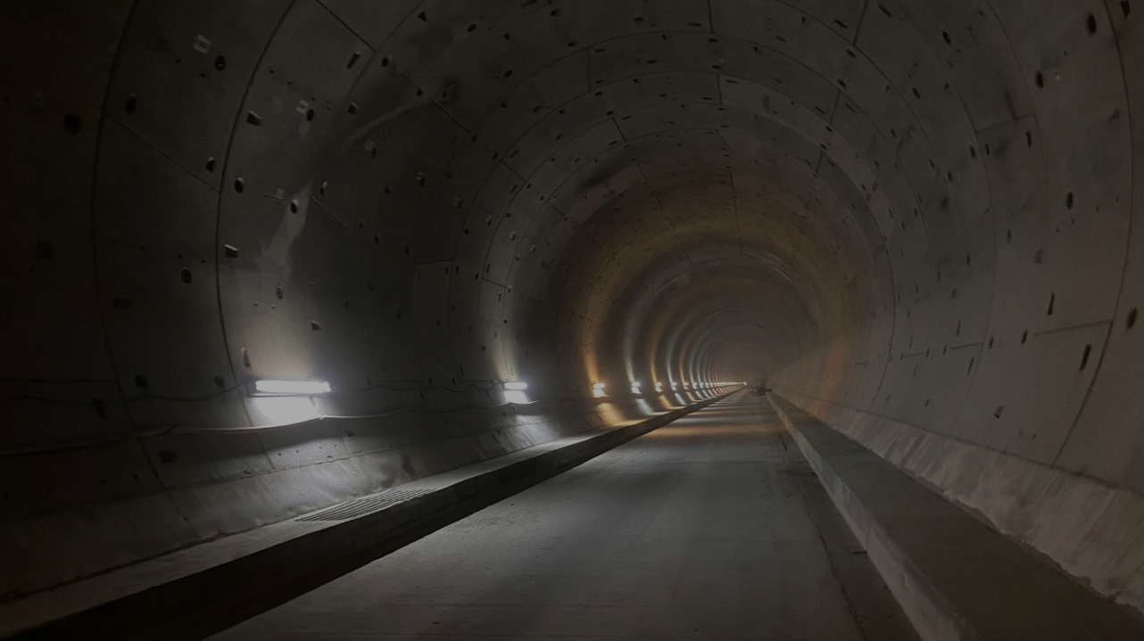

web:  www.ebw.tugraz.at
Thanks for today!
Questions?
Title Surname Name
mob: +43xxxx
mail: email@tugraz.at
web: www.ebw.tugraz.at
View into Southern Tube of Koralm-Tunnel (Western Portal minus ~8 km) Direction East, 03. October 2021

